Slide 1
GI Bill® Idaho Overview
Veterans Education Bureau Chief
208-780-1334
‘‘GI Bill® is a registered trademark of the U.S. Department of Veterans Affairs (VA). More information about education benefits offered by VA is available at the official U.S. government Web site at https://www.benefits.va.gov/gibill."

Slide 2
Idaho Division of Veteran Services - Education
State Approving Agency (SAA)
Mission:
To assess, inspect, approve and supervise Veteran education and training programs in Idaho offered by qualified institutions of higher learning, training establishments and licensing and certification agencies.

Slide 3
How can I use my GI Bill®? …almost any training
On-The-Job Training:
Law Enforcement, Fire, Energy Sector, Trucking
Apprenticeships:
Electrician, Plumber, HVAC, Mechanic
Non-College Degree facilities:
Truck Driving, Cosmetology, Real Estate, IT
Licensing and Certifications:
Cisco, Microsoft, CNA
Institutes of Higher Learning:
Colleges and Universities
Flight Schools:
Notes:
Aug 09 – Sept 15 – NVEST / SVA study
Studied 850k vets
Success rate – 72%
54% completed education
18% persisting
450k degrees
100k projected each year
27% Business/Marketing
14% in STEM
10% in health
Of these, 43% bachelors, 18% masters, 2% PHD

Slide 4
Apprenticeship and On-the-Job Training
“Skills, not Degrees”
Both on-the-job (OJT) and apprenticeship training programs are available for Veterans using their VA education benefits, including the Post-9/11 GI Bill®.
These programs allow Veterans to learn a trade or skill through training on the job participation rather than attending formal classroom instruction.
A Veteran generally enters into a training contract for a specific period with an employer or union, and at the end of the training period, the Veteran gains job certification or journeyman status.
Employers generally pay a reduced OJT/apprenticeship wage (must be at least 50% of journeyman wage). Unless the training establishment is operated by a Federal, State, or local government, periodic wage increases must be granted and by the last full month of training, the wage must be at least 85% of the wage for a fully trained employee.
Veterans in an approved program can use their GI Bill ® benefit and receive a tax-free stipend. The Post-9/11 GI Bill® stipend is the equivalent of the Monthly Housing Allowance (MHA) of an E-5 with dependents, which is paid in addition to the entry-level wage.

Slide 5
Post 9/11 GI Bill®
Apprenticeship and On-the-Job Training
Example
Apprenticeship w/ Company Wages Journeyman Wage is $24 / Hr.
Training Period | Apprentice Wage | VA Stipend | Monthly Total
First six months of training | $12/ $1920 * | $1164 / 100% of MHA | $3,084
Second six months of training | $14 / $2240 | $931 / 80% of MHA | $3,171
Third six months of training | $16 / $2560 | $698 / 60% of MHA | $3,258
Fourth six months of training | $18 / $2880 | $466 / 40% of MHA | $3,346
Remaining pursuit of training | $20 / $3200 | $233 / 20% of MHA | $3,433
Remaining pursuit of training | $22/ $3520 * | $233 / 20% of MHA | $3,753
* Start at 50% of journeyman wage & finish at least 85% of journeyman wage

Slide 6
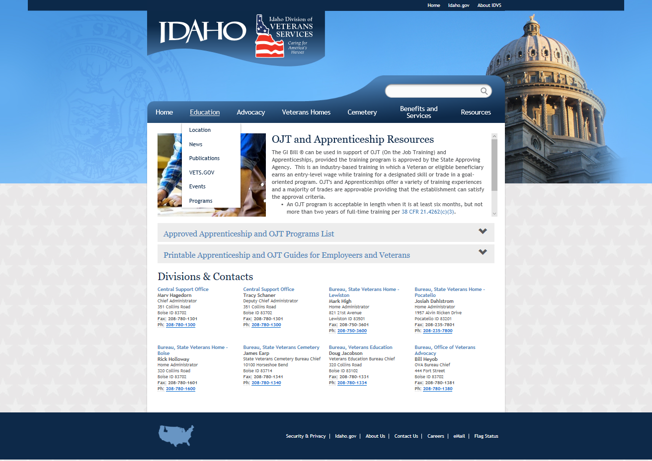
http://veterans.idaho.gov/StateBenefits
(List of VA & DOL Approved Employers in Idaho)

Slide 7
References
Ask the VA a Question (Use this function!) – This allows anyone to communicate directly with a VA education specialist
https://gibill.custhelp.va.gov/
Or Call the GI Bill ® helpline @ 1-888-GIBILL-1 (442-4551)
Important Websites:
www.va.gov/education/how-to-apply/(Apply for benefits / View COE) ***
www.ebenefits.va.gov/ebenefits/homepage (View COE)
www.va.gov/gi-bill-comparison-tool (Learn about / Compare facilities)
https://www.benefits.va.gov/gibill/school_locator.asp
(Schools / VA-approved facility search w/contact information)
http://www.nasaa-vetseducation.com/Contacts.aspx
(State Approving Agency) Find the office in your state
http://www.veterans.Idaho.gov/education (list of Idaho VA & DOL-Approved Employers)
https://labor.idaho.gov/dnn/Job-Seekers/Veterans-Services
Connie Stopher
Executive Director
Southern Idaho Economic Development Organization
O: (208) 732-6459
C: (208) 934-6041
connies@southernidaho.org
Doug Jacobson / Tonya Erhardt
Veterans Education Bureau Idaho Division of Veteran Services (State Approving Agency)
Phone: (208) 780-1334 / 1332 Fax: (208) 780-1331
education@veterans.idaho.gov
Robert J Feliciano
Veterans Local Employment Representative Idaho Dept. of Labor Meridian 208-364-7785 ext. 3624 Fax: 208-895-8441 Robert.Feliciano@labor.idaho.gov

Slide 8
?
Thanks for your service to our Nation!

Slide 9
The Missing Piece in our Talent Pipeline: Veterans Apprenticeships: https://youtu.be/r-5k1eBRLuc

Slide 10
Chapter 30 – Montgomery GI Bill®
Apprenticeship and On-the-Job Training
Example
Apprenticeship w/ Company Wages Journeyman Wage is $24 / Hr.
Training Period | Apprentice Wage | VA Stipend | Monthly Total
First six months of training | $12/ $1920 * | $1495 | $3,415
Second six months of training | $14 / $2240 | $1096.70 | $3,336.70
Third six months of training | $16 / $2560 | $697.90 | $3,257.90
Fourth six months of training | $18 / $2880 | $697.90 | $3,577.90
Remaining pursuit of training | $20 / $3200 | $697.90 | $3,897.90
Remaining pursuit of training | $22/ $3520 * | $697.90 | $4,217.90
* Start at 50% of journeyman wage & finish at least 85% of journeyman wage

